Slide 1
CTS-2 Vendor Benchmark Briefing
Benchmarking Lead: Ian Karlin (LLNL)
Team: Matt Leininger (LLNL), Josip Loncaric (LANL), Howard Pritchard (LANL), Doug Pase (Sandia), Anthony Agelastos (Sandia)

Slide 2
High Level CTS-2 Goals
Deliver relatively low risk cycles to our users
  This includes standing up, stabilizing and integrating systems quickly
Deliver these cycles with hardware that requires low porting effort
  Build on existing programming models and previous CTS and ATS machines
Deliver the best cost performance we can given the other constraints
  This includes capital and operating costs
Benchmarks are meant to help us address the cost performance part of our goals.

Slide 3
Why we added benchmarks for CTS-2
CTS-2 is focused on getting the best cost performance
There multiple viable processor families
Within each processor family there are multiple skus that could be viable
The goal of benchmarking requirements is to assist the offeror in selecting the most promising technologies on a cost performance basis.

Slide 4
Benchmarking Philosophy
Keep things as simple as possible, while still getting the information we need
  We aim to keep the benchmark projection cost down to enable bids from multiple integrators
Reuse benchmarks that vendors are familiar with from other procurements when possible

Slide 5
Two Types of Benchmarks
DOE Mini-apps
  Four smaller applications used to understand node performance and projected to estimate SU throughput
  Meant to roughly represent important workloads and applications at the ASC labs
Microbenchmarks
  Used to evaluate sub-systems
  Tied to specific SOW requirements

Slide 6
Mini-apps
Four representative DOE applications are used:
  HPCG
  LAGHOS
  Quicksilver
  SNAP
Single node problems are selected to minimize overall benchmark effort
Job sizes are selected to represent node level characteristics of production jobs
  Memory capacity per core (or per MPI task)
  Memory bandwidth or latency sensitivities
  Memory access patterns
  Computing requirements (double precision flops, integer, etc.)

Slide 7
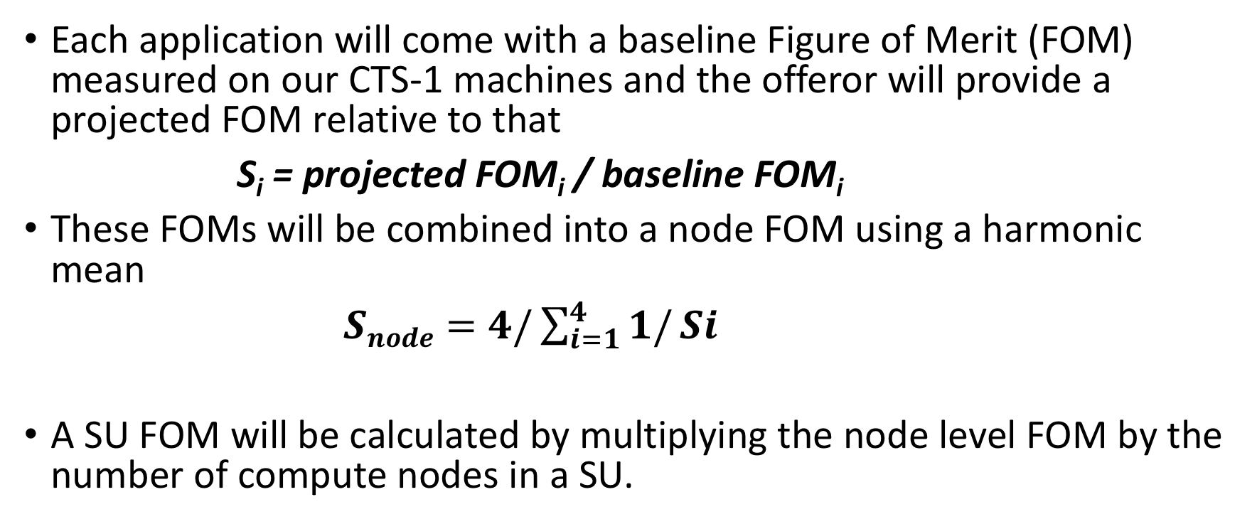
Performance Relative to CTS-1
Each application will come with a baseline Figure of Merit (FOM) measured on our CTS-1 machines and the offeror will provide a projected FOM relative to that
S_{i} = projected FOM_{i} / baseline FOM_{i}
These FOMs will be combined into a node FOM using a harmonic mean
$Snode=4/\sum_{i=1}^{4}{1/}Si$
A SU FOM will be calculated by multiplying the node level FOM by the number of compute nodes in a SU.

Slide 8
Microbenchmarks
Will be used to set some statement of work targets at contract time
Meant to understand the performance of various important subsystems
Memory performance
  STREAM is used to judge this for both a single core and all cores
Compute performance
  Peak node DGEMM gives us node level FLOPs
  Single core DAXPY gives us single core compute performance
Network performance
  Key latencies, throughputs and operations (e.g. AllReduce) are expected for 1 task per core/socket/node.
  Suggested benchmarks are provided: perftest, presta and osu_mbw_mr.

Slide 9
General Benchmark Rules
Benchmark codes should not be modified unless noted in benchmark descriptions
  CTS-2 aims to run our codes well as they are written today with minimal effort by our application teams
Vendors are encouraged to use the best compiler and flags for each application

Slide 10
What We are Expecting
We are expecting projections, though if you have the hardware you are bidding exact values are always better.
Projections can use:
  Previous hardware and modeling
  Simulators of the future nodes
  Other modeling and projection methods as appropriate
When possible projections should be recreatable by the labs if desired.
  Describe the methodology in enough detail that someone else can recreate it
  We expect bidders to document test hardware, compiler flags and other software used
  Simulations of the proposed hardware, will be described in similar detail, but may not be recreatable by the labs.

Slide 11
HPCG is driven by a multigrid preconditioned conjugate gradient algorithm that exercises the key kernels on a nested set of coarse grids
  Local symmetric Gauss-Seidel smoother with a sparse triangular solve
  The basic operations include sparse matrix-vector multiplication, vector updates, and global dot products
Reference implementation is written in C++ w/ MPI and OpenMP support
Mix of compute- and bandwidth-bound performance inhibitors
The Run Rules prescribe a fixed problem size per HPCG instance and allows the vendor to run as many instances and threads per instance as they would like to maximize HPCG workload throughput.

Slide 12
Higher-order hydro code
Mix of compute and memory bandwidth bound kernels
Depends on MFEM library where most of the runtime is spent

Slide 13
Quicksilver
Monte Carlo Transport Mini-app
Irregular data access results in memory latency usually being the bottleneck
Has one large loop where most of the runtime occurs

Slide 14
SNAP
Discrete Ordinates Mini-app
Large memory footprint and multiple types (groups, angles, and zones) of parallelism
Typically cache bandwidth limited on CPUs

Slide 15
Things not covered by our benchmarks
Networking beyond micro-benchmarks
Architecture decision points
GPU benchmarks
NVMe
Etc.
The proposed system will be evaluated on its ability to support these options not their performance. For any of these features we will work with the chosen integrator to select the best cost performance options as needed.

Slide 16
Notes to the Vendors
Benchmarks are just one of many factors in CTS-2 evaluation
Benchmarks are no less and no more important than those other factors (see future DRAFT SOW for more details)
If you think a chip that does not benchmark best is the right one for us bid it and tell us why
  E.g. power consumption and reliability are better
  E.g. better cost/performance
Other requirements matter as well so do not optimize your design only for the best benchmark numbers.
Remember this is a best value procurement focused on overall cost performance including operating costs and other factors (see slide 2) are also very important to our decision making.

Slide 17
Questions and Feedback
If you have questions later please send mail to:
  cts2-benchmarks@llnl.gov
Benchmarks are available here:
  https://hpc.llnl.gov/cts-2-benchmarks

Slide 18
Disclaimer
This document was prepared as an account of work sponsored by an agency of the United States government. Neither the United States government nor Lawrence Livermore National Security, LLC, nor any of their employees makes any warranty, expressed or implied, or assumes any legal liability or responsibility for the accuracy, completeness, or usefulness of any information, apparatus, product, or process disclosed, or represents that its use would not infringe privately owned rights. Reference herein to any specific commercial product, process, or service by trade name, trademark, manufacturer, or otherwise does not necessarily constitute or imply its endorsement, recommendation, or favoring by the United States government or Lawrence Livermore National Security, LLC. The views and opinions of authors expressed herein do not necessarily state or reflect those of the United States government or Lawrence Livermore National Security, LLC, and shall not be used for advertising or product endorsement purposes.
This work was performed under the auspices of the U.S. Department
of Energy by Lawrence Livermore National Laboratory under contract
DE-AC52-07NA27344. Lawrence Livermore National Security, LLC
LLNL-PRES-774947

